Slide 1
UNIT V

Slide 2
Flow graphs and Path testing: Basics concepts of path testing
Data Flow Testing: Basics of Data flow Testing ,
Logic Based Testing: Decision Tables
Software Metrics: Software Quality, Metrics for Analysis Model, Metrics for Design Model,
Metrics for source code, Metrics for testing, Metrics for maintenance
ref boris beizer

Slide 3
Control Flow Graphs and Path Testing
_{L1}
Control Flow Graph
A simplified, abstract, and graphical representation of a program’s control structure using process blocks, decisions and junctions.
_{IF}
_{A = B ?}
_{NO: ELSE DO}
_{Process Block}
_{Do Process A}
_{Decisions}
_{YES: THEN DO}
_{Junctions}
₁
₂
_{CASE-OF}
_{CASE 1}
₁
_{CASE 2}
_{Case Statement}
₂
_{CASE N}
_{Control Flow Graph Elements}
_{N}
ref boris beizer

Slide 4
Control Flow Graphs and Path Testing
_{L1}
Control Flow Graph Elements:
Process Block:
  A sequence of program statements uninterrupted by decisions or junctions with a single entry and single exit.
Junction:
  A point in the program where control flow can merge (into a node of the graph)
  Examples: target of GOTO, Jump, Continue
Decisions:
  A program point at which the control flow can (based on the evaluation of a condition).
  Examples: IF stmt. Conditional branch and Jump instruction.
Case Statements:
  A Multi-way branch or decision.
  Examples: In assembly language: jump addresses table, Multiple GOTOs, Case/Switch
  For test design, the Case statement and decision are similar.
ref boris beizer

Slide 5
Control Flow Graphs and Path Testing
_{L1}
Control Flow Graph Vs Flow Charts
Control Flow Graph | Flow Chart
Compact representation of the program | Usually a multi-page description
Focuses on Inputs, Outputs, and the control flow into and out of the block. | Focuses on the process steps inside
Inside details of a process block are not shown | Every part of the process block are drawn
ref boris beizer

Slide 6
Control Flow Graphs and Path Testing
_{L1}
Creation of Control Flow Graph from a program
One statement to one element translation to get a Classical Flow chart
Add additional labels as needed
Merge process steps
A process box is implied on every junction and decision
Remove External Labels
Represent the contents of elements by numbers.
We have now Nodes and Links
INPUT X, Y
Z := X + Y
V := X - Y
IF Z >= 0 GOTO SAM
JOE: Z := Z + V
SAM: Z := Z - V
FOR N = 0 TO V
Z := Z - 1
NEXT N
END
_{Z >= 0 ?}
_{NO}
_{INPUT X, Y}
_{Z := X + Y}
_{V := X - Y}
_{JOE}
_{Z := Z - 1}
_{LOOP}
_{N := 0}
_{Z := Z - V}
_{SAM}
_{Z := Z + V}
_{N = V ?}
_{NO}
_{N := N+1}
_{YES}
_{END}
_{One to One Flow Chart}
ref boris beizer

Slide 7
Control Flow Graphs and Path Testing
_{L1}
Creation of Control Flow Graph from a program
One statement to one element translation to get a Classical Flow chart
Add additional labels as needed
Merge process steps
A process box is implied on every junction and decision
Remove External Labels
Represent the contents of elements by numbers.
We have now Nodes and Links
INPUT X, Y
Z := X + Y
V := X - Y
IF Z >= 0 GOTO SAM
JOE: Z := Z + V
SAM: Z := Z - V
FOR N = 0 TO V
Z := Z - 1
NEXT N
END
_{Z >= 0 ?}
_{NO}
_{P1}
_{JOE}
_{P4}
_{LOOP}
_{P3}
_{SAM}
_{P2}
_{N = V ?}
_{NO}
_{P5}
_{YES}
_{END}
_{Simplified Flow Graph}
ref boris beizer

Slide 8
Control Flow Graphs and Path Testing
_{L1}
Creation of Control Flow Graph from a program
One statement to one element translation to get a Classical Flow chart
Add additional labels as needed
Merge process steps
A process box is implied on every junction and decision
Remove External Labels
Represent the contents of elements by numbers.
We have now Nodes and Links
INPUT X, Y
Z := X + Y
V := X - Y
IF Z >= 0 GOTO SAM
JOE: Z := Z + V
SAM: Z := Z - V
FOR N = 0 TO V
Z := Z - 1
NEXT N
END
₁
₂
₃
₄
₅
₆
₇
_{Simplified Flow Graph}
ref boris beizer

Slide 9
Control Flow Graphs and Path Testing
_{L1}
Linked List Notation of a Control Flow Graph
  Node Processing, label, Decision Next-Node
  1 (BEGIN; INPUT X, Y; Z := X+Y ; V := X-Y) : 2
  2 ( Z >= 0 ? ) : 4 (TRUE)
  : 3 (FALSE)
  3 (JOE: Z := Z + V) : 4
  4 (SAM: Z := Z – V; N := 0) : 5
  5 (LOOP; Z := Z -1) : 6
  6 (N = V ?) : 7 (FALSE)
  : END (TRUE)
  7 (N := N + 1) : 5
₁
₂
₃
₄
₅
₆
₇
ref boris beizer

Slide 10
Control Flow Graphs and Path Testing
_{L2}
Path Testing Concepts
Path is a sequence of statements starting at an entry, junction or decision and ending at another, or possibly the same junction or decision or an exit point.
Link is a single process (block) in between two nodes.
Node is a junction or decision.
Segment is a sequence of links. A path consists of many segments.
Path segment is a succession of consecutive links that belongs to the same path. (3,4,5)
  Length of a path is measured by # of links in the path or # of nodes traversed.
  Name of a path is the set of the names of the nodes along the path. (1,2,3 4,5, 6)
  (1,2,3,4, 5,6,7, 5,6,7, 5,6)
  Path-Testing Path is an “entry to exit” path through a processing block.
ref boris beizer

Slide 11
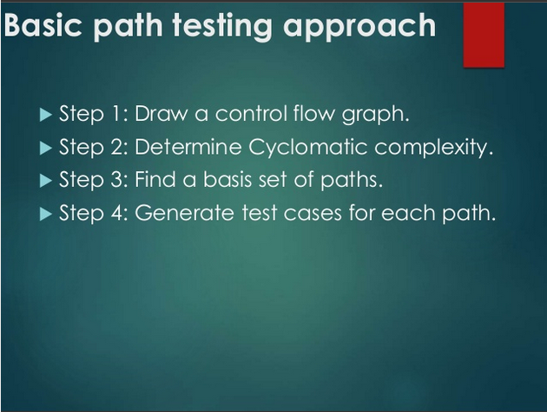
ref boris beizer

Slide 12
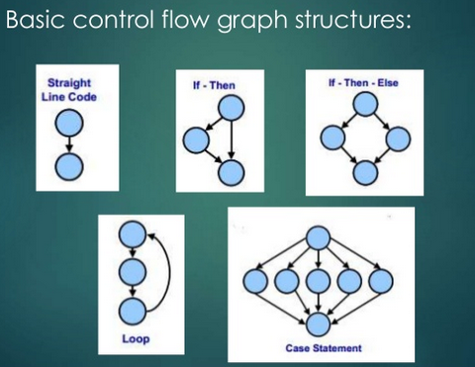
ref boris beizer

Slide 13

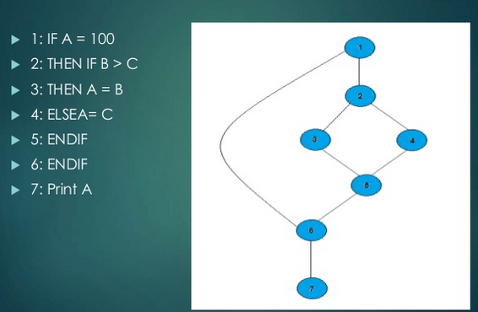
ref boris beizer

Slide 14
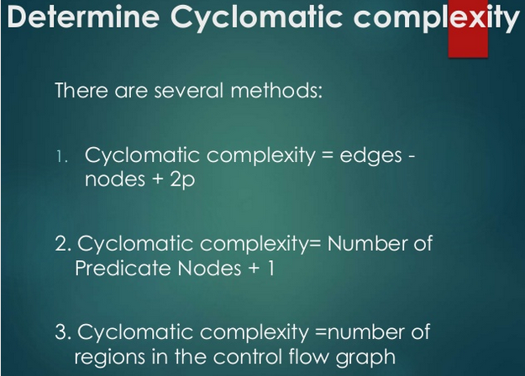
ref boris beizer

Slide 15
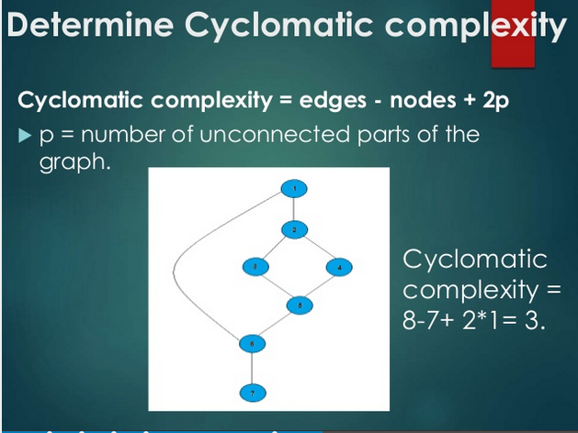
ref boris beizer

Slide 16
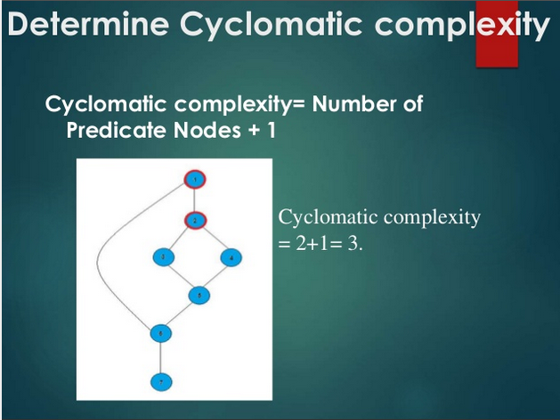
ref boris beizer

Slide 17
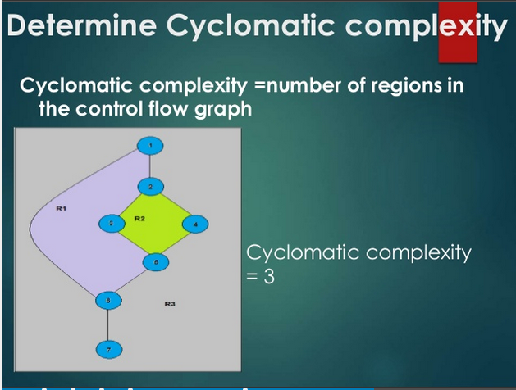
ref boris beizer

Slide 18
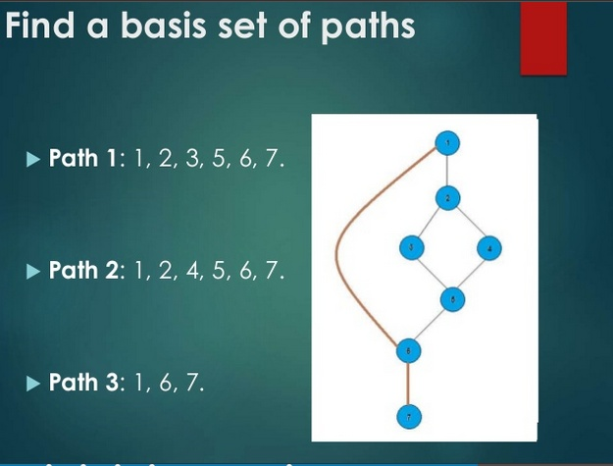
ref boris beizer

Slide 19
Control Flow Graphs and Path Testing
_{L2}
Path Testing Concepts
Path Testing Criteria :
  Path Testing (P∝ ):
  Execute all possible control flow paths thru the program; but typically restricted to entry-exit paths.
  Implies 100% path coverage.
  Statement Testing ( P₁) :
  Execute all statements in the program at least once under the some test.
  100% statement coverage => 100% node coverage.
  Denoted by C1
  C1 is a minimum testing requirement in the IEEE unit test standard: ANSI 87B.
  Branch Testing (P₂) :
  Execute enough tests to assure that every branch alternative has been exercised at least once under some test.
  Denoted by C2
  Objective: 100% branch coverage and 100% Link coverage.
  For well structured software, branch testing & coverage include statement coverage
ref boris beizer

Slide 20
Control Flow Graphs and Path Testing
_{L2}
Picking enough (the fewest) paths for achieving C1+C2
₂
₁
_{Z >= 0 ?}
_{NO}
_{f}
_{P1}
_{a}
_{b}
_{NO}
_{c}
_{END}
_{YES}
_{N = V ?}
_{LOOP}
_{SAM}
_{g}
_{e}
_{d}
₆
₄
₃
₅
Paths | Decisions |  | Process-link
 | 2 | 5 | a | b | c | d | e | f | g
abdeg | No | Y | Y | Y |  | Y | Y |  | Y
acdeg | Y | Y | Y |  | Y | Y | Y |  | Y
abdefeg | No | Y | Y | Y |  | Y | Y | Y | Y
acdefeg | Y | No | Y |  | Y | Y | Y | Y | Y
Does every decision have Y & N (C2)?
Are call cases of case statement marked (C2)?
Is every three way branch covered (C2)?
Is every link covered at least once (C1)?
Make small changes in the path changing only 1 link or node at a time.
ref boris beizer

Slide 21
Control Flow Graphs and Path Testing
_{L2}
Revised path selection Rules
Pick the simplest and functionally sensible entry/exit path
Pick additional paths as small variations from previous paths. (pick those with no loops, shorter paths, simple and meaningful)
Pick additional paths but without an obvious functional meaning (only to achieve C1+C2 coverage).
Be comfortable with the chosen paths to achieve C1+C2
ref boris beizer

Slide 22
Control Flow Graphs and Path Testing
_{L2}
Effectiveness of Path Testing
  Path testing catches ~65% of Unit Test Bugs ie., ~35% of all bugs.
  More effective for unstructured than structured software.
  Limitations
    Path testing may not do expected coverage if bugs occur.
    Path testing may not reveal totally wrong or missing functions.
    Unit-level path testing may not catch interface errors among routines.
    Data base and data flow errors may not be caught.
    Unit-level path testing cannot reveal bugs in a routine due to another.
    Not all initialization errors are caught by path testing.
    Specification errors cannot be caught.
ref boris beizer

Slide 23
Control Flow Graphs and Path Testing
_{L2}
  A lot of work
    Creating flow graph, selecting paths for coverage, finding input data values to force these paths, setting up loop cases & combinations.
  Careful, systematic, test design will catch as many bugs as the act of testing.
  Test design process at all levels at least as effective at catching bugs as is running the test designed by that process.
ref boris beizer

Slide 24
Control Flow Graphs and Path Testing
_{L3}
Predicates, Predicate Expressions
Path
  A sequence of process links (& nodes)
Predicate
  The logical function evaluated at a decision : True or False. (Binary , boolean)
Compound Predicate
  Two or more predicates combined with AND, OR etc.
Path Predicate
  Every path corresponds to a succession of True/False values for the predicates traversed on that path.
  A predicate associated with a path.
  “ X > 0 is True “ AND “W is either negative or equal to 122” is True
ref boris beizer

Slide 25
Control Flow Graphs and Path Testing
_{L3}
Predicates, Predicate Expressions…
Predicate Interpretation
  The symbolic substitution of operations along the path in order to express the predicate solely in terms of the input vector is called predicate interpretation.
  An input vector is a set of inputs to a routine arranged as a one dimensional array.
  Predicate interpretation may or may not depend on the path.
  Path predicates are the specific form of the predicates of the decisions along the selected path after interpretation.
ref boris beizer

Slide 26
Control Flow Graphs and Path Testing
_{L3}
Predicates, Predicate Expressions…
Process Dependency
  An input variable is independent of the processing if its value does not change as a result of processing.
  An input variable is process dependent if its value changes as a result of processing.
  A predicate is process dependent if its truth value can change as a result of processing.
  A predicate is process independent if its truth value does not change as a result of processing.
  Process dependence of a predicate doesn’t follow from process dependence of variables
  If all the input variables (on which a predicate is based) are process independent, then predicate is process independent.
ref boris beizer

Slide 27
Control Flow Graphs and Path Testing
_{L4}
Achievable Paths
Objective is to select & test just enough paths to achieve a satisfactory notion of test completeness such as C1 + C2.
Extract the program’s control flow graph & select a set of tentative covering paths.
For a path in that set, interpret the predicates.
Trace the path through, multiplying the individual compound predicates to achieve a boolean expression. Example: (A + BC) ( D + E)
Multiply & obtain sum-of-products form of the path predicate expression:
AD + AE + BCD + BCE
Each product term denotes a set of inequalities that, if solved, will yield an input vector that will drive the routine along the selected path.
A set of input values for that path is found when any of the inequality sets is solved.
A solution found => path is achievable. Otherwise the path is unachievable.
ref boris beizer

Slide 28
Control Flow Graphs and Path Testing
_{L7}
Application of Path Testing
Integration, Coverage, and Paths in Called Components
Mainly used in Unit testing, especially new software.
In an Idealistic bottom-up integration test process – integrating one component at a time. Use stubs for lower level component (sub-routines), test interfaces and then replace stubs by real subroutines.
In reality, integration proceeds in associated blocks of components. Stubs may be avoided. Need to think about paths inside the subroutine.
To achieve C1 or C2 coverage:
  Predicate interpretation may require us to treat a subroutine as an in-line-code.
  Sensitization becomes more difficult.
  Selected path may be unachievable as the called components’ processing may block it.
Weaknesses of Path testing:
It assumes that effective testing can be done one level at a time without bothering what happens at lower levels.
predicate coverage problems & blinding.
ref boris beizer

Slide 29
Control Flow Graphs and Path Testing
_{L7}
Implementation & Application of Path Testing
Application of path testing to New Code
  Do Path Tests for C1 + C2 coverage
  Use the procedure similar to the idealistic bottom-up integration testing, using a mechanized test suite.
  A path blocked or not achievable could mean a bug.
  When a bug occurs the path may be blocked.
ref boris beizer

Slide 30
Control Flow Graphs and Path Testing
_{L7}
Implementation & Application of Path Testing
Application of path testing to Maintenance
  Path testing is applied first to the modified component.
  Use the procedure similar to the idealistic bottom-up integration testing, but without using stubs.
  Select paths to achieve C2 over the changed code.
  Newer and more effective strategies could emerge to provide coverage in maintenance phase.
ref boris beizer

Slide 31
Control Flow Graphs and Path Testing
_{L7}
Implementation & Application of Path Testing
Application of path testing to Rehosting
  Path testing with C1 + C2 coverage is a powerful tool for rehosting old software.
  Software is rehosted as it’s no more cost effective to support the application environment.
  Use path testing in conjunction with automatic or semiautomatic structural test generators.
ref boris beizer

Slide 32
Control Flow Graphs and Path Testing
_{L7}
Implementation & Application of Path Testing
Application of path testing to Rehosting..
  Process of path testing during rehosting
  A translator from the old to the new environment is created & tested. Rehosting process is to catch bugs in the translator software.
  A complete C1 + C2 coverage path test suite is created for the old software. Tests are run in the old environment. The outcomes become the specifications for the rehosted software.
Another translator may be needed to adapt the tests & outcomes to the new environment.
The cost of the process is high, but it avoids risks associated with rewriting the code.
Once it runs on new environment, it can be optimized or enhanced for new
functionalities (which were not possible in the old environment.)
ref boris beizer

Slide 33
_{U2}
  Data - Flow Testing - Basics

Slide 34
Data - Flow Testing - Basics
_{U2}
  Definition:
  Data-flow testing is a white box testing technique that can be used to detect improper use of data values due to coding errors.
  Data Flow Testing is a family of test strategies based on selecting paths through the program’s control flow in order to explore the sequence of events related to the status of data objects.
  Testing focuses on the points at which variables receive values and the points at which these values are used.
  Example:
  Pick enough paths to assure that every data item has been initialized prior to its use, or that all objects have been used for something.

Slide 35
Data - Flow Testing - Basics
_{U2}
Advantages of Data Flow Testing:
  Data Flow testing helps us to pinpoint any of the following issues:
  A variable that is declared but never used within the program.
  A variable that is used but never declared.
  A variable that is defined multiple times before it is used.
  De-allocating a variable before it is used.

Slide 36
Data - Flow Testing - Basics
_{U2}
Motivation:
  it is our belief that, just as one would not feel confident about a program without executing every statement in it as part of some test,
  one should not feel confident about a program without having seen the effect of using the value produced by each and every computation.

Slide 37
Data - Flow Testing - Basics
_{U2}
DATA FLOW MACHINES: There are two types of data flow machines with different architectures.
Von Neumann machines
Multi-instruction, multi-data machines (MIMD).
(1). Von Neumann Machine Architecture:
  Most computers today are von-neumann machines.
  This architecture features interchangeable storage of instructions and data in the same memory units.

Slide 38
Data - Flow Testing - Basics - Motivation
_{U2}
  Program Control flow with Von Neumann’s paradigm
  Given m, n, p, q, find e.
  e = (m+n+p+q) * (m+n-p-q)
  a := m + n
  b := p + q
  c := a + b
  d := a - b
  e := c * d
a = n+m
b=p+q
c=a+b
d=a-b
e=c*d
  Multiple representations of control flow graphs possible.

Slide 39
Data - Flow Testing - Basics
_{U2}
  The Von Neumann machine Architecture executes one instruction at a time in the following, micro instruction sequence:
    Fetch instruction from memory
    Interpret instruction
    Fetch operands
    Process or Execute
    Store result
    Increment program counter
    GOTO 1

Slide 40
Data - Flow Testing - Basics
_{U2}
Multi-instruction, Multi-data machines (MIMD) Architecture:
These machines can fetch several instructions and objects in parallel.
They can also do arithmetic and logical operations simultaneously on different data objects.
The decision of how to sequence them depends on the compiler.

Slide 41
Data - Flow Testing - Basics
_{U2}
Multi-instruction, Multi-data machines (MIMD) Architecture:
These machines can fetch several instructions and objects in parallel.
They can also do arithmetic and logical operations simultaneously on different data objects.
The decision of how to sequence them depends on the compiler.

Slide 42
Data - Flow Testing - Basics
_{U2}
Data Object State and Usage: Data Objects can be created, killed and used.
They can be used in two distinct ways:
In a Calculation
As a part of a Control Flow Predicate.
The following symbols denote these possibilities:
  Defined: d - defined, created, initialized etc
  Killed or undefined: k - killed, undefined, released etc
  Usage: u - used for something (c - used in Calculations, p - used in a predicate)

Slide 43
Data - Flow Testing - Basics
_{U2}
Defined (d):
An object is defined explicitly when it appears in a data declaration.
Or implicitly when it appears on the left hand side of the assignment.
It is also to be used to mean that a file has been opened.
A dynamically allocated object has been allocated.
Something is pushed on to the stack.
A record written.

Slide 44
Data - Flow Testing - Basics
_{U2}
2. Killed or Undefined (k):
  An object is killed on undefined when it is released or otherwise made unavailable.
  When its contents are no longer known with certitude (with aboslute certainity / perfectness).
  Release of dynamically allocated objects back to the availability pool.
  Return of records.
  The old top of the stack after it is popped.
  An assignment statement can kill and redefine immediately. For example, if A had been previously defined and we do a new assignment such as A : = 17, we have killed A's previous value and redefined A

Slide 45
Data - Flow Testing - Basics
_{U2}
3. Usage (u):
A variable is used for computation (c) when it appears on the right hand side of an assignment statement.
A file record is read or written.
It is used in a Predicate (p) when it appears directly in a predicate.

Slide 46
Data - Flow Testing - Basics - Motivation
_{U2}
  Program Flow using Data Flow Machines paradigm
  BEGIN
  PAR DO
  READ m, n, n, p, q
  END PAR
  PAR DO
  a := m+n
  b := p+q
  END PAR
  PAR DO
  c := a+b
  d := a-b
  END PAR
  PAR DO
  e := c * d
  END PAR
  END
n
m
p
q
a := m+n
b := p+q
c := a+b
d := a-b
e := c * d
  The interrelations among the data items remain same.

Slide 47
Data - Flow Testing - Basics – Data Flow Anomalies
_{U2}
  Actions on data objects
    - no action from START to this point
    From this point till the EXIT
      - d normal
      - u anomaly
    - k anomaly
    k- normal
    u - normal - possibly an anomaly
    d - possibly anomalous

Slide 48
Data - Flow Testing - Basics
_{U2}
  Data Flow Anomaly State graph
    Data Object State
        K, D, U, A
    Processing Step
        k, d, u

Slide 49
Data - Flow Testing - Basics
_{U2}
  Data Flow Anomaly State graph
    Object state
    Unforgiving Data flow state graph
Undefined
K
k, u
d
u
d, k
U
D
A
u
Anomalous
d
Defined
d, k, u
Used

Slide 50
Data - Flow Testing - Basics
_{U2}
  Data Flow Anomaly State graph
    Forgiving Data flow state graph
u
A ⇒ DD, DK, KU
k
u
KU
K
k
k
u
DK
d
k
u
d
U
k
D
d
u
d
DD
u
d

Slide 51
Data - Flow Testing - Basics
_{U2}
  Data Flow State Graphs
    Differ in processing of anomalies
    Choice depends on Application, language, context

Slide 52
Data - Flow Testing - Basics
_{U2}
  Static vs Dynamic Anomaly Detection
    Static analysis of data flows
    Dynamic analysis
    Intermediate data values

Slide 53
Data - Flow Testing - Basics
_{U2}
Insufficiency of Static Analysis (for Data flow)
  Validation of Dead Variables
  Validation of pointers in Arrays
  Validation of pointers for Records & pointers
  Dynamic addresses for dynamic subroutine calls
  Identifying False anomaly on an unachievable path
  Recoverable anomalies & Alternate state graph
  Concurrency, Interrupts, System Issues

Slide 54
Data - Flow Testing - Basics
_{U2}
  Data Flow Model
    Based on CFG
    CFG annotated with program actions
    link weights : dk, dp, du etc..
    Not same as DFG
    For each variable and data object

Slide 55
Data - Flow Testing - Basics : Data Flow Model
_{U2}
  Procedure to Build:
    Entry & Exit nodes
    Unique node identification
    Weights on out link
    Predicated nodes
    Sequence of links
      Join
      Concatenate weights
      The converse

Slide 56
Data - Flow Testing - Basics : Data Flow Model
_{U2}
  Example: a^{n} – 1
Z = b + ---------
START a - 1
INPUT a, b, n
Z := 0
IF a = 1 THEN Z := 1
GOTO DONE1
r := 1 c := 1
POWER:
c := c * a
r := r + 1
IF r <= n THEN GO TO POWER
Z := (c – 1) / (a – 1)
DONE1:
Z := b + Z
END

Slide 57
Data - Flow Testing - Basics – Data Flow model
_{U2}
  CFG for the Example
Read a,b,n
Z := 0
Z := 1
Z := b + Z
1
2
5
6
a = 1?
P1
Y
Z := (c-1)/(a-1)
3
P2
4
r < n ?
r := 1 c:=1
r := r+1, c:= c*a
Y

Slide 58
Data - Flow Testing - Basics – Data Flow model
_{U2}
  CFG annotated – Data Flow Model for Z
d or kd
cd or ckd
1
d
2
5
6
a = 1?
P1
Y
d or kd
3
P2
4
r < n ?
Y

Slide 59
Data - Flow Testing - Basics – Data Flow model
_{U2}
  CFG annotated – Data Flow Model for c
1
2
5
6
a = 1?
P1
Y
-d
c-
3
ckd or kd
P2
4
r < n ?
Y

Slide 60
Data - Flow Testing - Basics – Data Flow model
_{U2}
  CFG annotated – Data Flow Model for r
1
2
5
6
a = 1?
P1
Y
-d
p-
3
ckd or kd
P2
4
r < n ?
Y

Slide 61
Data - Flow Testing - Basics – Data Flow model
_{U2}
  CFG annotated – Data Flow Model for b
1
d
2
5
c
6
a = 1?
P1
Y
3
P2
4
r < n ?
Y

Slide 62
Data - Flow Testing - Basics – Data Flow model
_{U2}
  CFG annotated – Data Flow Model for n
1
d
2
5
6
a = 1?
P1
Y
p-
3
P2
4
r < n ?
Y

Slide 63
Data - Flow Testing - Basics – Data Flow model
_{U2}
  CFG annotated – Data Flow Model for a
1
d
2
5
6
a = 1?
P1
p
c-
3
c
P2
4
r < n ?
Y

Slide 64
LOGIC-BASED TESTING
  Programmers and Logic
“Logic” is one of the most often used words In programmers’ vocabularies but one of their least used techniques.
Boolean Algebra is being the simplest form of logic.
Boolean Algebra is to logic as arithmetic is to mathematics.

Slide 65
LOGIC-BASED TESTING
  Decision Tables
A decision table is a table that consists of four areas called the condition stub, the condition entry, the action stub and the action entry.
Each column of the table is a rule that specifies the conditions under which the actions named in the action stub will take place.

Slide 66
LOGIC-BASED TESTING
  An example of a Decision Table
CONDITION ENTRY
 | RULE 1 | RULE 2 | RULE 3 | RULE 4
CONDITION 1 CONDITION 2 CONDITION 3 CONDITION 4 | YES YES NO NO | YES I YES YES | NO NO NO NO | NO I I YES
ACTION 1 ACTION 2 ACTION 3 | YES NO NO | YES NO NO | NO YES NO | NO NO YES
CONDITION STUB
ACTION STUB
ACTION ENTRY

Slide 67
LOGIC-BASED TESTING
The condition stub is a list of names of conditions.
A rule specifies whether a condition should or should not be met for the rule to be satisfied. “yes” means that the conditions must be met, and “No” means that conditions must not be met, and “I” means that the conditions plays no part in the rule, or it is immaterial to the rule.
The action stub names the actions the routine will take or initiate if the rule is satisfied.
If the action entry is “YES” , the action will take place; if “NO” , the action will not take place.
Some of the rules are not specified by the decision table for which a default action to be taken are called Default Rules.

Slide 68
LOGIC-BASED TESTING
Action 1 will take place if condition 1 and 2 are met and if condition 3 and 4 are not met (rule 1) or if condition 1,3 and 4 are met (rule 2)
 | RULE 1 | RULE 2 | RULE 3 | RULE 4
CONDITION 1 CONDITION 2 CONDITION 3 CONDITION 4 | YES YES NO NO | YES I YES YES | NO NO NO NO | NO I I YES
DEFAULT ACTION | YES | YES | YES | YES

Slide 69
LOGIC-BASED TESTING
Decision Table Processors
Decision tables can be automatically translated into code and as such are a higher order language.
The decision table translator checks the source decision table for consistency and completeness and fills in any required default rules.
Decision tables as a source language have the virtue of clarity, direct correspondence to specifications, and maintainability.

Slide 70
LOGIC-BASED TESTING
Expansion of Immaterial Cases
 | Rule 2.1 | Rule 2.2 | Rule 4.1 | Rule 4.2 | Rule 4.3 | Rule 4.4
CONDITION1 CONDITION2 CONDITION3 CONDITION4 | YES YES YES YES | YES NO YES YES | NO YES YES YES | NO YES NO YES | NO NO NO YES | NO NO YES YES

Slide 71
LOGIC-BASED TESTING
The expansion of an Inconsistent Specification
Rule 1.1 | Rule 1.2 | Rule 2.1 | Rule 2.2
Yes Yes Yes No | Yes No Yes No | Yes No Yes No | Yes No No No
Yes No | Yes No | No Yes | No Yes
 | Rule 1 | Rule 2
Condition 1 Condition 2 Condition 3 Condition 4 | Yes I Yes No | Yes No I No
Action 1 Action 2 | Yes No | No yes

Slide 72
LOGIC-BASED TESTING
Test Case Design
Test case design by decision tables begins with examining the specification’s consistency and completeness.
This is done by expanding all immaterial cases and checking the expanded tables.
Once the specification have been verified, the objective of the test case is to show that the implementation provides the correct action for all combinations of predicate values.

Slide 73
LOGIC-BASED TESTING
Decision tables and Structure
Decision tables can also be used to examine a program’s structure.
D
R1
8
Action 1
B
D
D¹
A
R3
1
A
B
B¹
R2
9
Action 3
A¹
C
C
R4
R5
D
D
C¹
R6
10
Action 2
D¹

Slide 74
LOGIC-BASED TESTING
 | Rule 1 | Rule 2 | Rule 3 | Rule 4 | Rule 5 | Rule 6
Condition A Condition B Condition C Condition D | Yes Yes I Yes | Yes No I I | Yes Yes I No | No I Yes I | No I No Yes | No I No No
Action 1 Action 2 Action 3 | Yes No No | Yes No No | No Yes No | No Yes No | No Yes No | No No Yes
The decision table corresponding to the previous decision tree

